Slide 1
Data Mining Project Proposal
Group Doreamon:
Abdul Gafar Manuel Meque
Chih-Ming Chen
Sachit Mahajan

Slide 2
Data Mining Project Proposal
Group Doreamon:
Abdul Gafar Manuel Meque
Chih-Ming Chen
Sachit Mahajan
- Reddit Opinion Mining

Slide 3
Problem Description
What Knowledge?
Given a Post p with upvotes u and downvotes d
Can we predict the opinion polarity (negative | positive) based on u & d?
Can we Predict the u,d distribution based on p?
The relationship between post emotion/polarity and its words under different subreddit.

Slide 4
Work flow
Reddit
Dataset
Data Cleaning e.g. removing stop words

Slide 5
Work flow
Train
Data
80%
Reddit
Dataset
Data Cleaning e.g. removing stop words
Test
Data
20%

Slide 6
Work flow
Extracted features:
1. Vector Space Model
2. Latent Topic Model
Feature
Extraction (Methodology)
Train
Data
Feature Set
80%
Reddit
Dataset
Data Cleaning e.g. removing stop words
Test
Data
20%

Slide 7
Work flow
Extracted features:
1. Vector Space Model
2. Latent Topic Model
Feature
Extraction (Methodology)
Train
Data
Feature Set
80%
Reddit
Dataset
Data Cleaning e.g. removing stop words
Test
Data
20%
Assistant
Resources
Opinion
Lexicon
Emotion
Lexicon
…
WordNet
Python NLTK

Slide 8
Work flow
Extracted features:
1. Vector Space Model
2. Latent Topic Model
Feature
Extraction (Methodology)
Train
Data
Feature Set
80%
Reddit
Dataset
Data Cleaning e.g. removing stop words
Statistics
Test
Data
20%
Data Analysis,
Feature Analysis
Viaualization
Assistant
Resources
Data Visualization:
1. Histogram
2. Word Cloud
3. Clustering
Opinion
Lexicon
Emotion
Lexicon
…
WordNet
Python NLTK

Slide 9
Work flow
Extracted features:
1. Vector Space Model
2. Latent Topic Model
Feature
Extraction (Methodology)
Train
Data
Feature Set
80%
Reddit
Dataset
Data Cleaning e.g. removing stop words
Classifier
Statistics
Test
Data
20%
Data Analysis,
Feature Analysis
Viaualization
Assistant
Resources
Predictions
Data Visualization:
1. Histogram
2. Word Cloud
3. Clustering
Opinion
Lexicon
Emotion
Lexicon
…
WordNet
Python NLTK
Algorithm Comparison,
Performance Evaluation
Accuracy

Slide 10
Work flow
Reddit
Dataset
Text Processing
Patterns
Result
Analysis
Assistant
Resources
Data Analysis,
Feature Analysis
Visualization
Opinion
Lexicon
Emotion
Lexicon
…
WordNet
Python NLTK

Slide 11
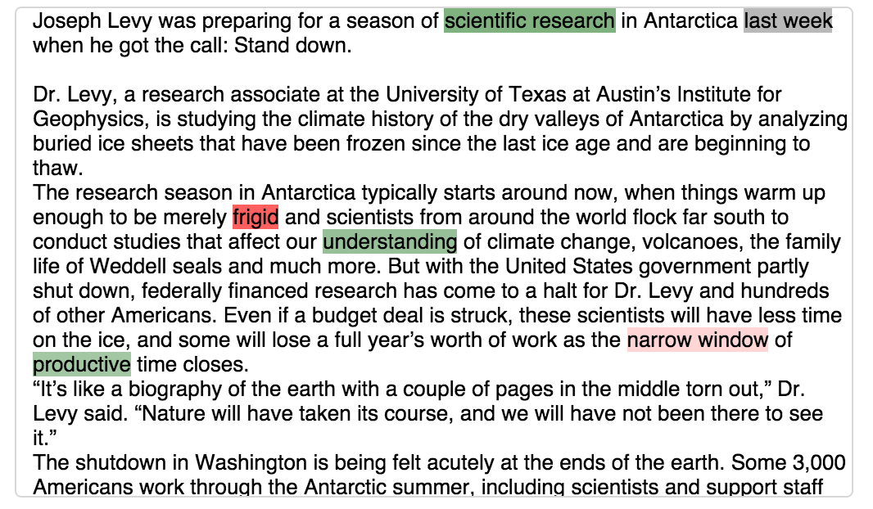
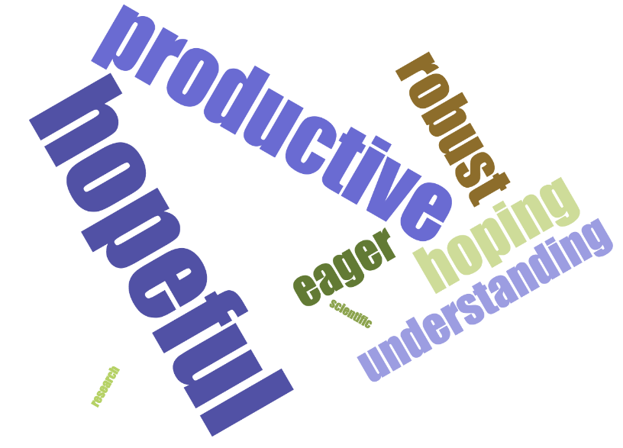
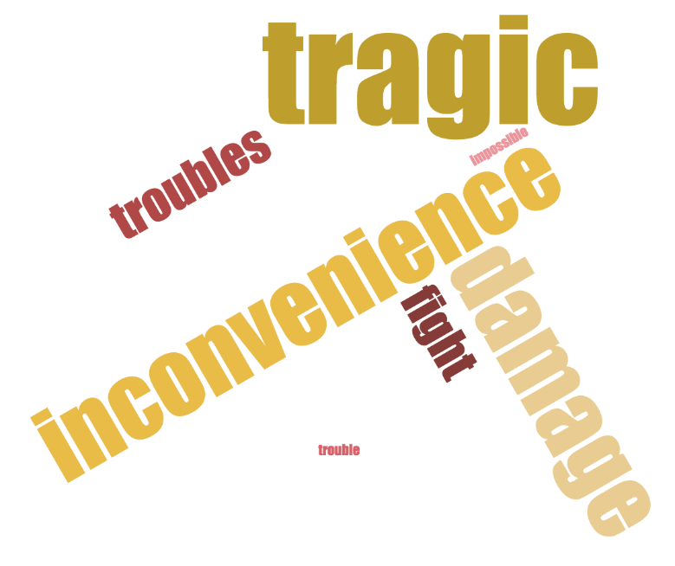
A Sketch
In a subreddit, given a post
Upvotes: 10
Downvotes: 1
Positive? Negative?
Neutral?

Slide 12
A Sketch
For each subreddit
Positive
Neutral
Negative
Topic Words
N-Gram TF
N-Gram IDF
Avg. Scores: 10
Avg. Scores: 5
Avg. Scores: 1

